Slide 1
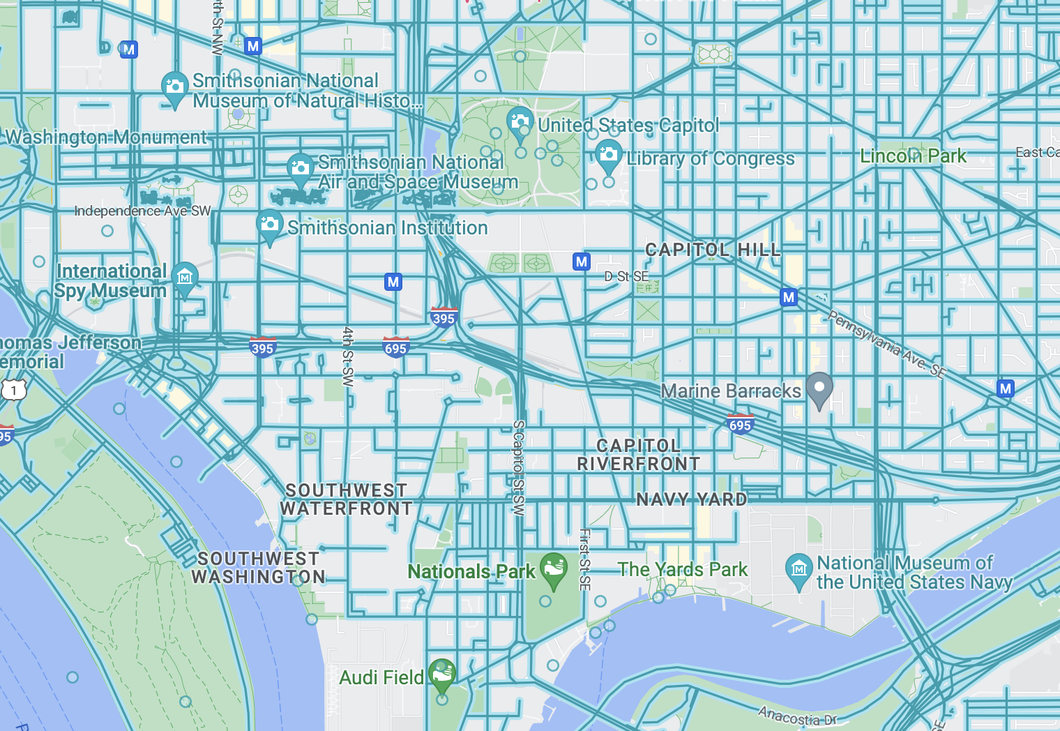
Gun Violence and Economic Vitality
Harshitha Tumkur Kailasa Murthy, Vishwas Bhaktavatsala, Kristopher Chou, Yeh-Min Lu
Project Motivation: By finding areas where violence correlates with low economic vitality, we are able to highlight locations where improvements can be made. Doing so, hopefully the city is able to become a safer place

Slide 2
What we have done so far
Exploring Datasets : We have explored various data sources and identified the potential parameters to tell the story of South-west DC
Data Cleaning: We have run data cleaning steps(removing NA values,, filtered the data according Tract codes and edit various columns to consume right data.
Exploratory Data Analysis : experimented with different types of visualizations, such as bar graphs, pie charts, line graphs, and maps. We have begun plotting graphs and finding ways to visualize the data.
Data representation : we have tried to pick certain parameters representing demographic data, crime data, Housing, Income data.
All of our data has come from open data sources.

Slide 3
DATA TRENDS AND COMPARISONS - Demographics
AGE AND POPULATION TRENDS
INCOME TRENDS
We have created the pdfs for these dashboards which we presented during the meeting, which is under the link.
PDF Name: IncomeAgeTrends.pdf

Slide 4
Economic well-being & kinds of crime
ECONOMIC TRENDS
FAMILY / COMMUNITY TRENDS
SAFETY / RISKY TRENDS
We have created the pdfs for these dashboards which we presented during the meeting, which is under the link.
PDF Name: EconomicCrimeTrends.pdf

Slide 5
Affordable Housing Locations and GunCrime
LOCATION TRENDS
CONCENTRATED CRIME TRENDS
We have created the pdfs for these dashboards which we presented during the meeting, which is under the link.
PDF Name: AffordableHousingandGunCrime.pdf

Slide 6
POVERTY and CRIME DATA VISUALIZATIONS
POVERTY TRENDS
CRIME TRENDS
We have created the pdfs for these dashboards which we presented during the meeting, which is under the link.
PDF Name: PovertyCrimeTrends.pdf

Slide 7
Results and Observations
Datasets that Team 1 has explored are Age Trends, Crime dataset, Housing dataset, Economic Well-being dataset, Income dataset, Poverty dataset.
We have tried to present and plot as many variables as possible to understand the story of South-west DC better.
Some correlations we have found:
Affordable housing and gun related crime
Income and Ward location
Crime and Ward location
Median Income across Washington DC
Income amongst different ethnic groups
Poverty against various races
Kinds of Crime in different wards.

Slide 8
Challenges and Limitations
Challenges:
Combining all the various type of data into one overall visualization.
Determining which graphs are the best fit when representing multiple data categories since we have a considerable number of datapoints to summarize within one graph.
Sometimes charts appear to be presentable, but the findings are still misleading. Trying to make graphs more straightforward and precise.10
Limitations:
Limited datasets and resources.
Lack of further analysis, diagrams cannot be further analysed.
Lack of tools and research that we have to deal with.
Unable to change the transparency of heatmaps

Slide 9
Extension
Correlate
Age and income
Race and crime
Next steps
Creating the dashboard : Researching on better technology to represent it in an
finalizing the visualizations : finalizing the graphs that needs to finally added to the dashboard.
Make visualizations more interactive.
Plans to complete the project: Complete the dashboard, conclude data, finalize visualizations.

